Slide 1


IDS 1721
Computing and Problem Solving for STEM
Chapter 07
The second Dimension

Slide 2
Population growth model
Introduction to Population Growth Models
Population growth models describe how populations evolve over time. A common approach is to represent the population as a vector, where each element corresponds to a specific group, such as age or stage. Changes in the population are governed by a transition matrix that describes how individuals move between groups.
Applications:
Ecology: Modeling species population dynamics.
Economics: Studying workforce age distribution.
Epidemiology: Tracking the spread of diseases across regions.

Slide 3
Problem Statement
In a closed ecosystem, there are four species of animals, each influencing the population growth of the others. The population dynamics of the species are governed by the equation:
P_{t+1}=A⋅P_{t}
Where:
P_{t} is a column vector representing the populations of the four species at time t.
A is a 4×4 transition matrix representing growth rates and interactions between species.
P_{t+1} is the population vector at time t+1.

Slide 4
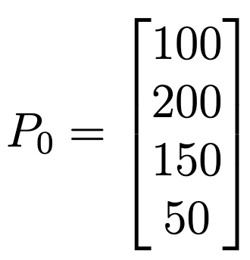
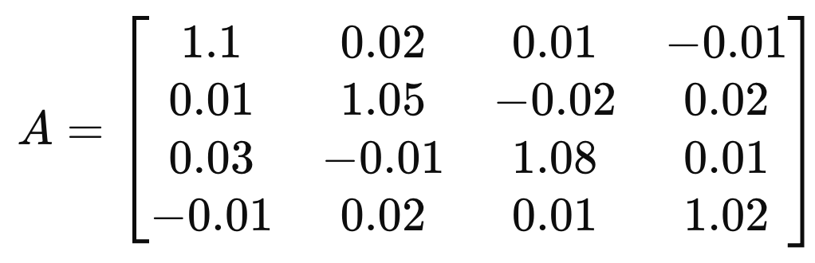
Initial State
Let the initial population vector be
Define the transition matrix A as:

Slide 5
Understanding the
Transition Matrix
The transition matrix models the interactions and growth dynamics of four species in a closed ecosystem.
Each element of the matrix A represents a specific interaction or growth rate between the species.
Diagonal element A_{ii} represent the intrinsic growth rate of each species.
Example:
A₂₂ = 1.05 means species 2 grows at 5%.

Slide 6
Understanding the
Transition Matrix
Off-diagonal elements Aij (i≠j) represent interactions between species:
  A positive value indicates that the species has a supportive or beneficial influence.
  A negative value indicates that the species has a competitive or detrimental influence.
Example:
  A₁₄ =−0.01: Species 4 inhibits the growth of Species 1.
  A₃₁ =0.03: Species 1 supports the growth of Species 3.

Slide 7
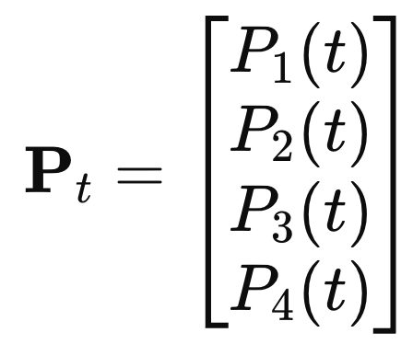
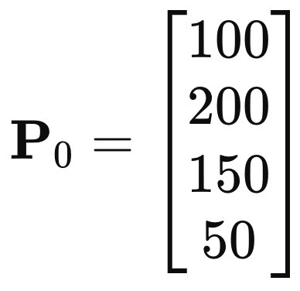
Understanding the Population vector
Structure of the Population Vector
P₁(t): Population of Species 1 at time t.
P₂(t): Population of Species 2 at time t.
P₃(t): Population of Species 3 at time t.
P₄(t): Population of Species 4 at time t.
For example, at the initial time (t=0)
  Species 1 starts with a population of 100,
  Species 2 starts with a population of 200, … and so on ...

Slide 8
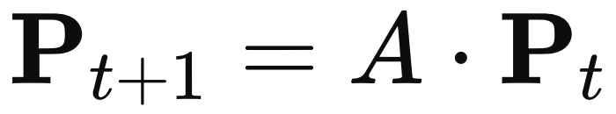
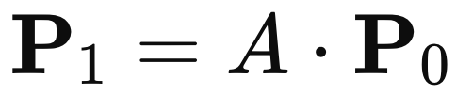
Interpretation
At each time step:
The intrinsic growth of each species (determined by the diagonal elements of A) contributes to its new population.
The interactions between species (off-diagonal elements of A) modify the population growth or decline by influence of other species.
The first entry of P₁ is calculated as:
P₁(1)=(1.1)(100)+(0.02)(200)+(0.01)(150)+(−0.01)(50)=112
Similar calculations are performed for the other species.

Slide 9
In MATLAB, the product of the transition matrix and the population vector is performed using the * operator.
i.e., P₁ = A * P₀
i.e., P₂ = A * P₁
i.e., P₃ = A * P₂ … and so on ...

Slide 10
Task I: Simulate Population Growth
Write a MATLAB script to calculate and display the population vector P_{t} for t=1 to t=10.
Store the population of each species at each time step in a matrix.
Task II: Visualize the results
Plot the population of each species over time. Use a different color for each species and add appropriate labels, legends, and a title.

Slide 11
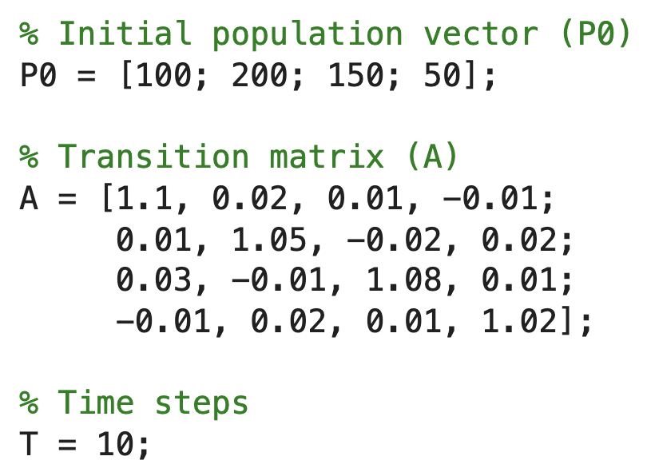
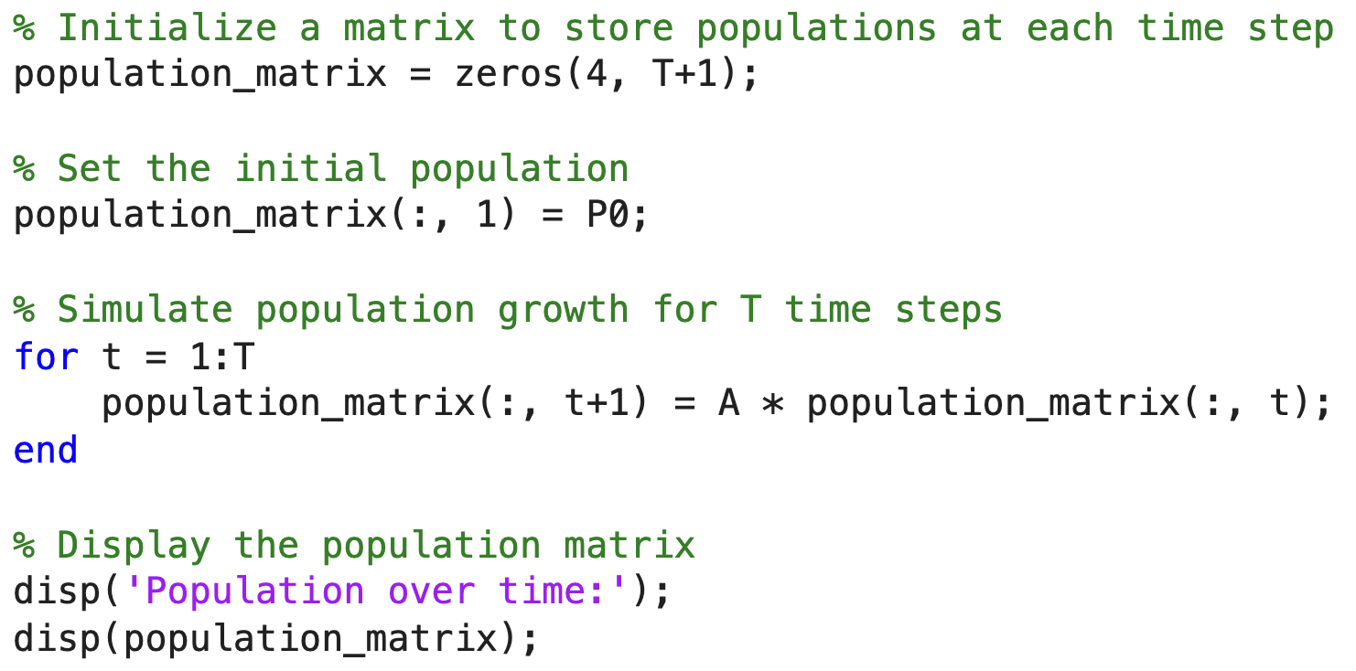

Slide 12
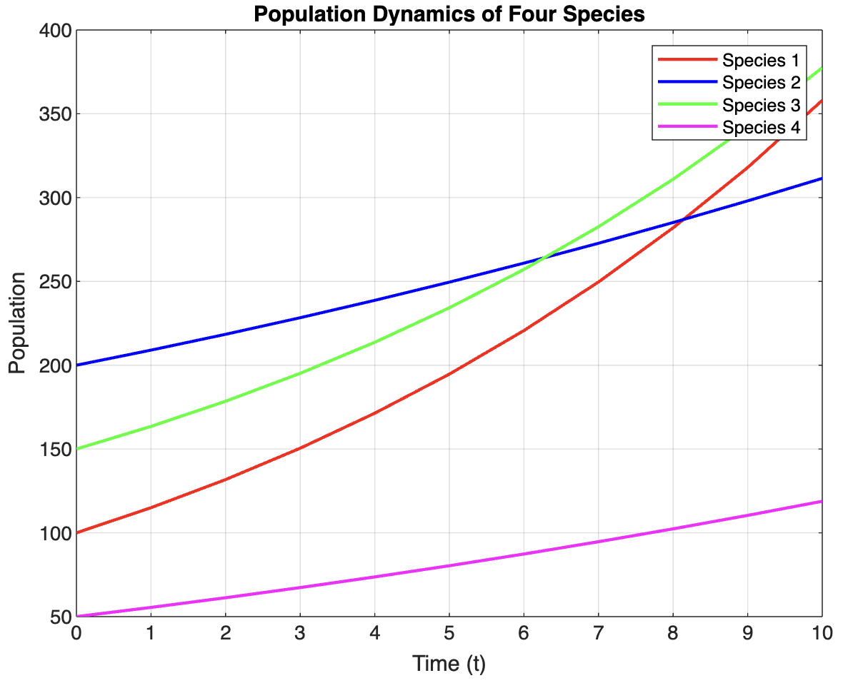
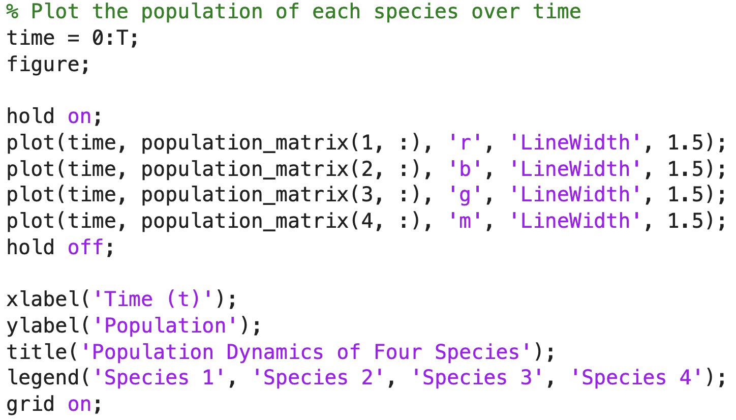

Slide 13
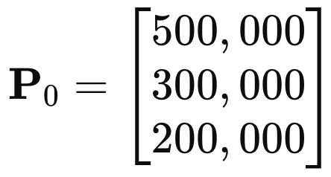
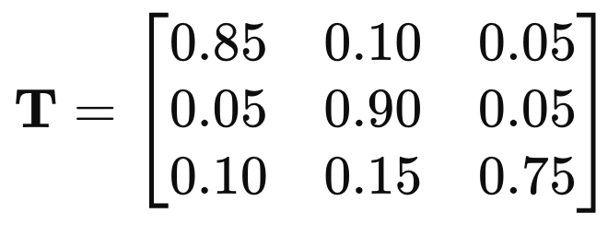
Exercise
Use a simplified dataset representing the population of three regions:
Region A: Urban area
Region B: Suburban area
Region C: Rural area
Initial population distribution (P₀):
Transition probabilities (T):
Each element T(i, j) represents the fraction of the population moving from region j to i in one year.

Slide 14
Tasks
Predict Future Populations:
  Use a loop to compute the population distribution for the next 10 years.
Visualize the Results:
  Plot the population of each region over the 10 years. Use a line plot with different colors for each region.
Calculate Total Population:
  At each year, calculate the total population across all regions and display it.

Slide 15
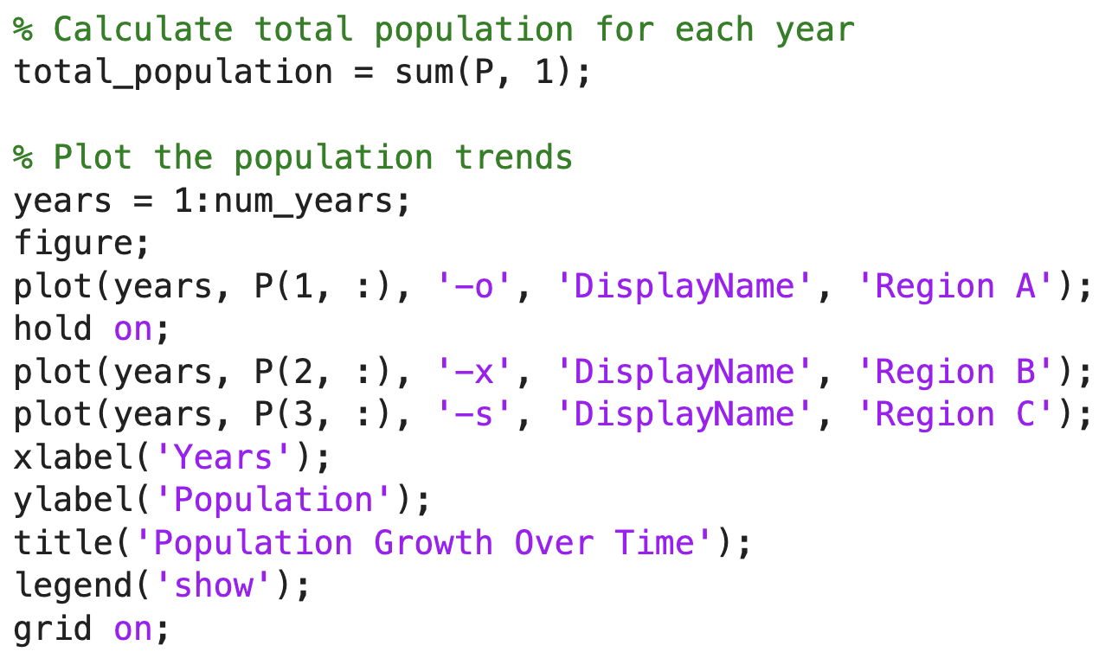
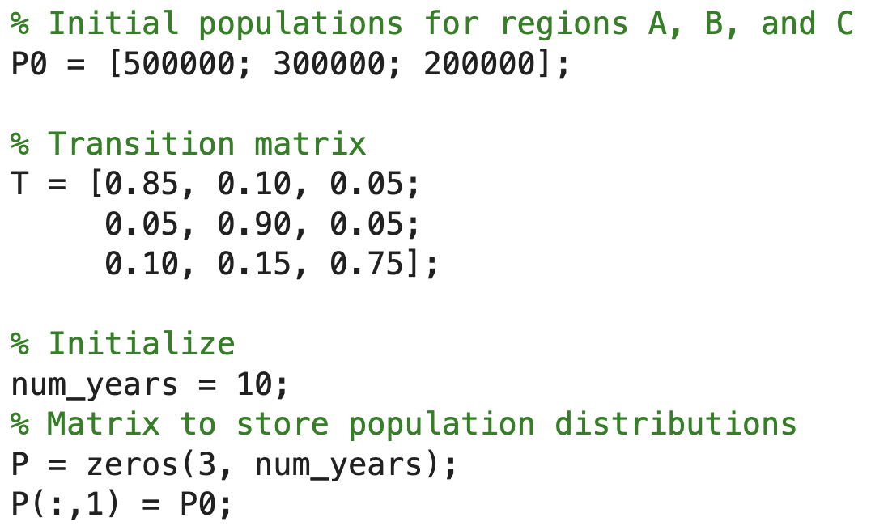
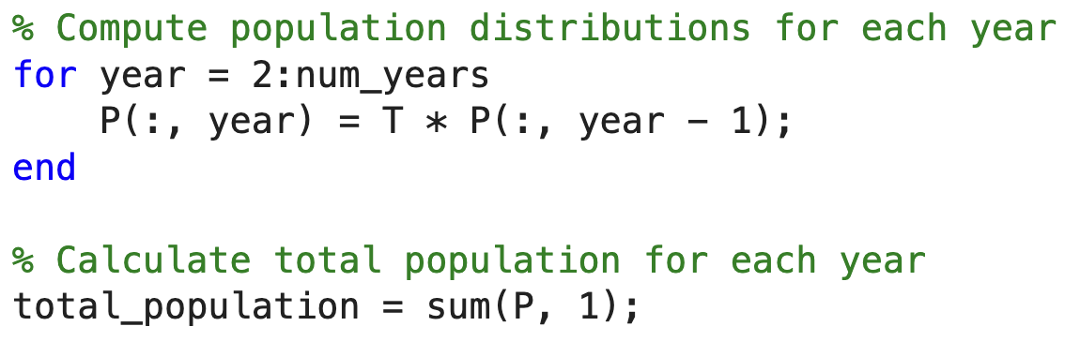
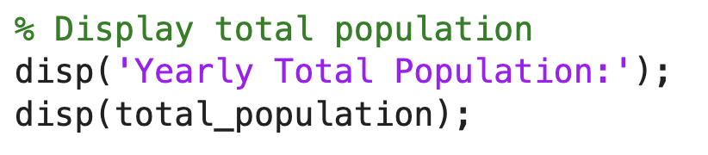

Slide 16
